Slide 1
Term project - team4
202031879 Lee Jaeseong
201935093 Lee dongjin
202035324 KIM TAEMIN

Slide 2
contents
1) Business object
2) Data curation
3) Data inspection
4) Preprocessing
4) Modeling
5) Evaluation
6) Deployment
7) Impression

Slide 3

Business object
South Korea sets target to achieve carbon neutrality by 2050
Power consumption is one of the causes of high carbon emissions
The purpose is to find ways for consumers to reduce power consumption.

Slide 4
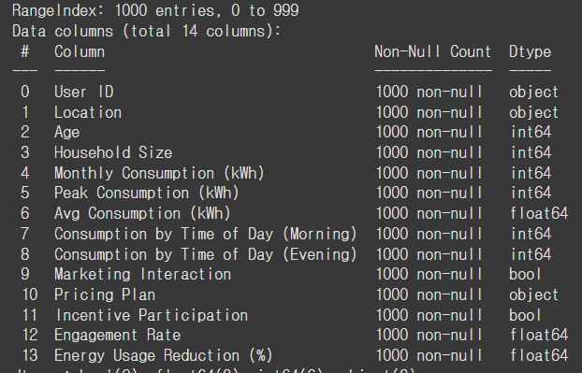
Data inspection & Data curation
We found the data in KAGGLE - Personalized Energy Marketing Analytics Dataset
Column : 14
Raw : 1000
Multiple types of data are mixed, such as numerical, category, boolean, etc

Slide 5
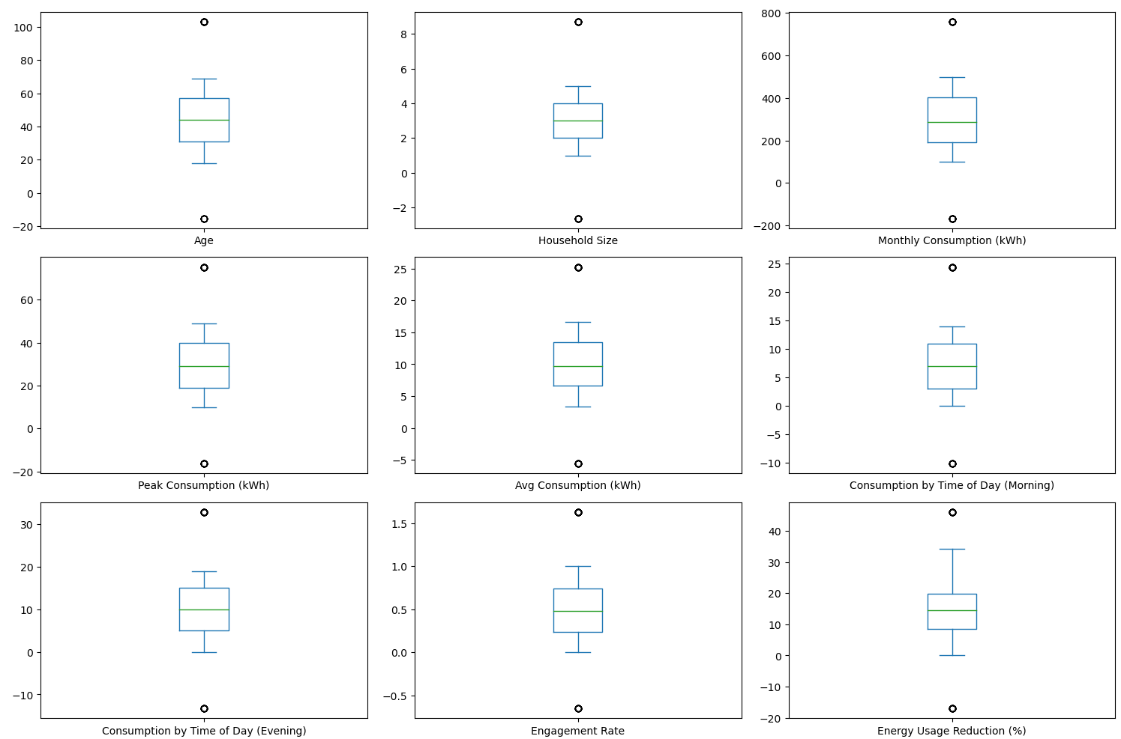
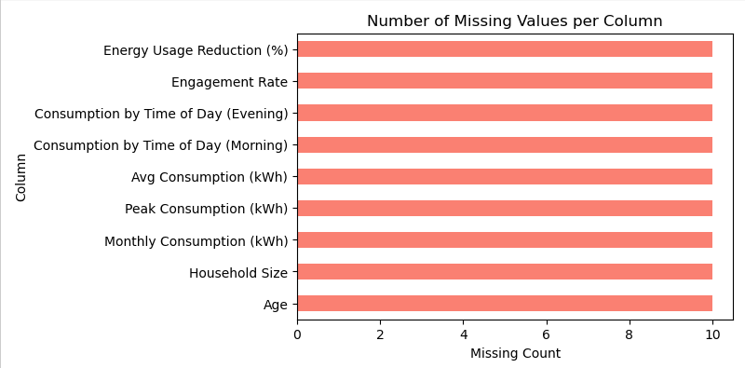
PreProcessing
Because it is clear data, outliers and missing values were inserted.

Slide 6
Preprocessing
1. Remove unnecessary columns: User ID
2. Isolation of target variables: Reduce energy usage (%)
4. Use Robustscaler to remove outlier, and remove the NA because missing value is small
3. apply Standardscaler for numerical variables and OneHotencoder for categorical variables

Slide 7
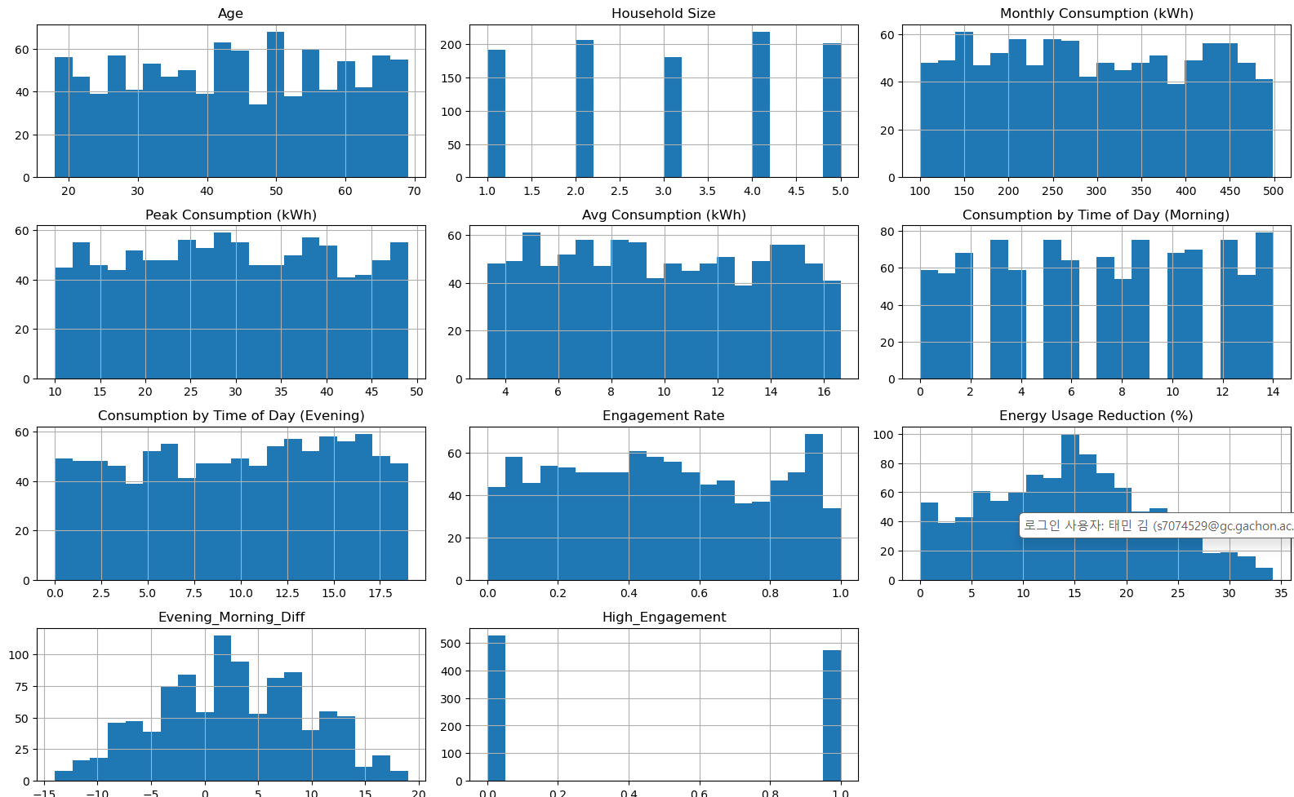
PreProcessing
(Reasons for applying standard scaler)
Adjust only the numerical size because the data is not skidded and the distribution of columns is nomal distribution (bell-shaped)

Slide 8
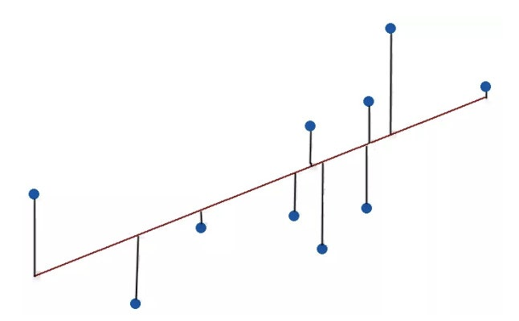
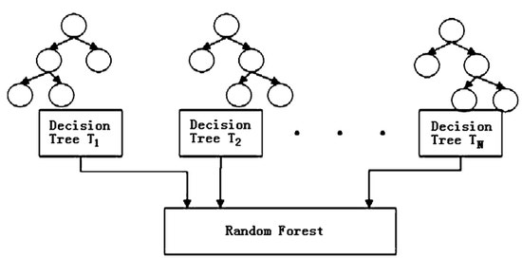
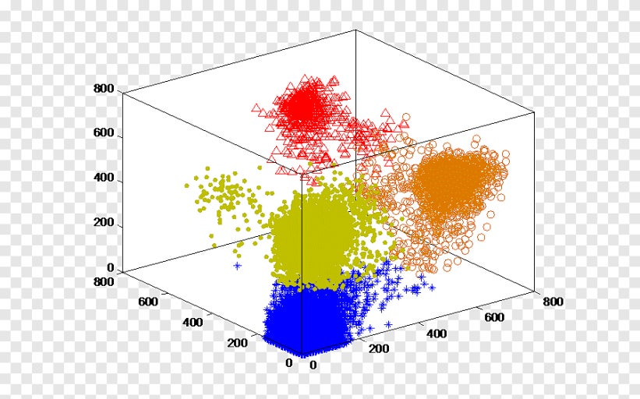
Modeling & evaluation

Slide 9
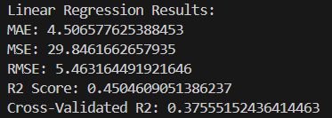

regression
Cross-validation results show R2 is 37%, less than half prediction
I've tried normalization regression, but the explanatory power still doesn't exceed 50%

Slide 10

classification
To use the random forest algorithm, Label the top 30% high and 70% low of the power reduction rate
Use the StratifiedKfold to learn appropriately
However, the recall and precision values are 65% lower compared to the accumulation

Slide 11
Clssification (try to improve the score)
Following the 3 step
Hyperparmeter tuning by using gridsearchcv
Treshold setting
Using Smote algorithm ( 3:7 => unbalanced class)

Slide 12

Hyperparmeter tuning
Best parameter
max_depth : 10, min_samples_leaf: 2 min_samples_split : 5 n_estimators : 200

Slide 13
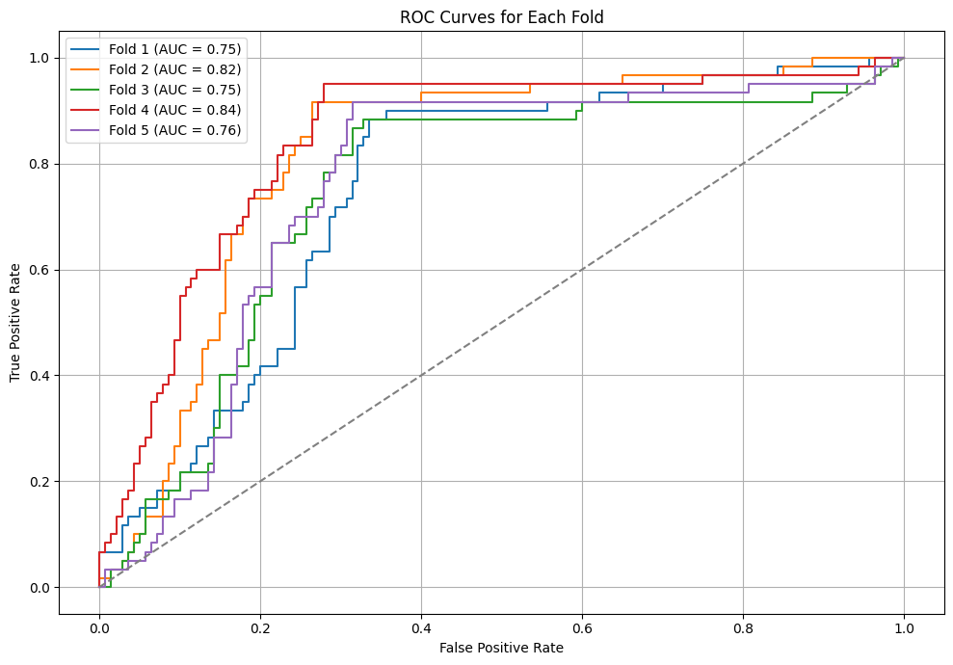

Threshold setting
Draw the ROC curve for each fold and set each best value
This is because the data of each fold is different, so a different plot is drawn.
However, since each fold has different thresholds, it is difficult to use specific thresholds for new data

Slide 14
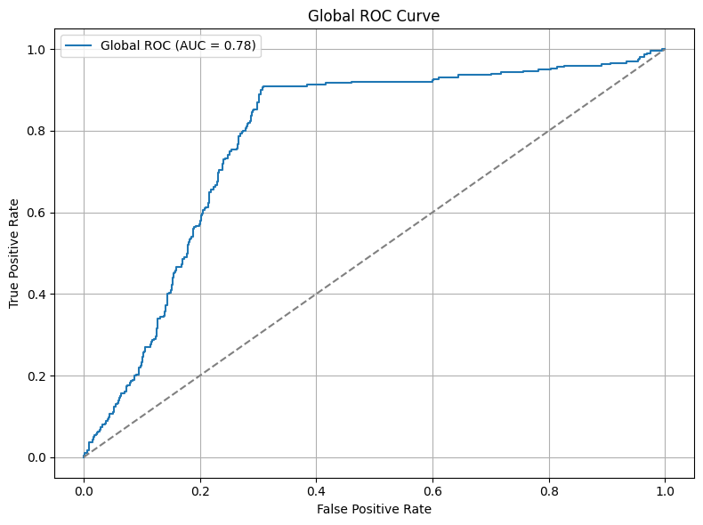

Threshold setting
The threshold of each fold is averaged to generate 'global_best_treshold’.
Global ROC = 0.78
General threshold = 0.3059

Slide 15
Classification – after 3step
Before 3step
Precision and f1 score are up by about 10%
The accuracy is up about 3.5%
Recall is up 15%
After 3step

Slide 16
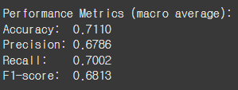
Compare with Decsion tree
When all parameters were the same and additional application algorithms were the same, all scores were better random algorithms than decision trees.
In particular, the biggest difference was recall. This is that random forest predicts true positive better.

Slide 17
Gmm clustering
Reason for using GMM
Regression and Classification fails to predict the Target(Energy Usage Reduction)
The target may not behave as a continuous numeric value, instead has an underlying cluster structure.

Slide 18
Gmm clustering
Used Features
PCA(with Marketing Interaction_True, Incentive Participation_True)
Peak Consumption(When usage peaks the most)
Target(Energy Usage Reduction) (The actual outcome)

Slide 19
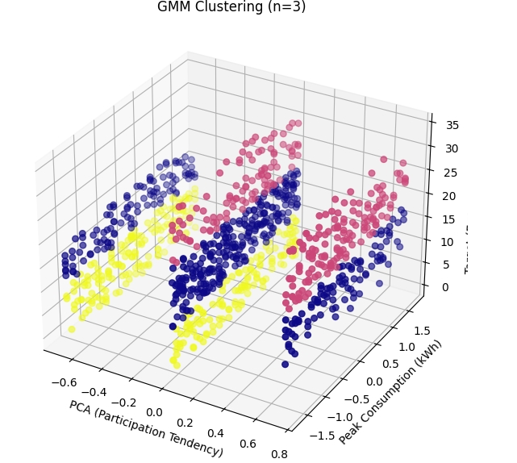
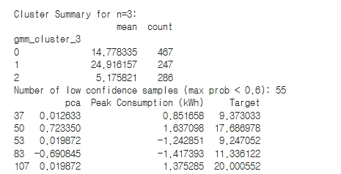
Gmm clustering (n=2 ~ 6)(N=3)
Clear segmentation into 3 levels of Target
Balanced sample distribution
Moderate low-confidence samples(Best Option)

Slide 20
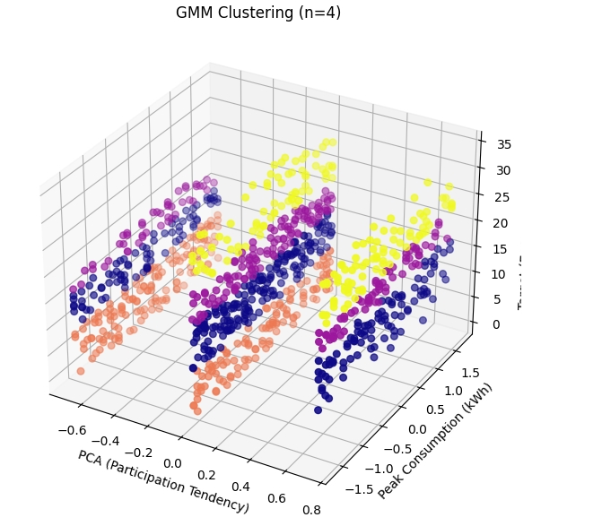
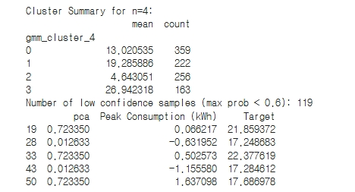
Gmm clustering (n=2 ~ 6)(N=4)
Over-segmentation (ambiguous)
Too many Low-Confidence Sample
Harder to Interpret

Slide 21
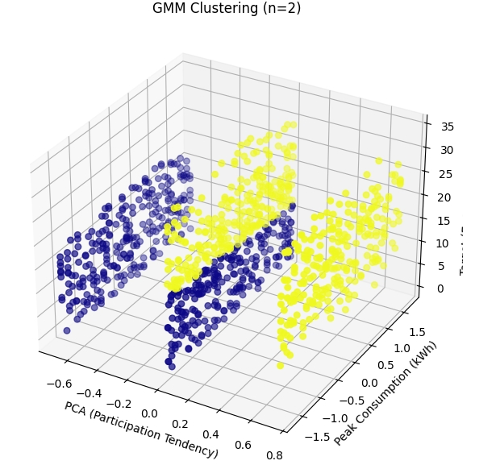
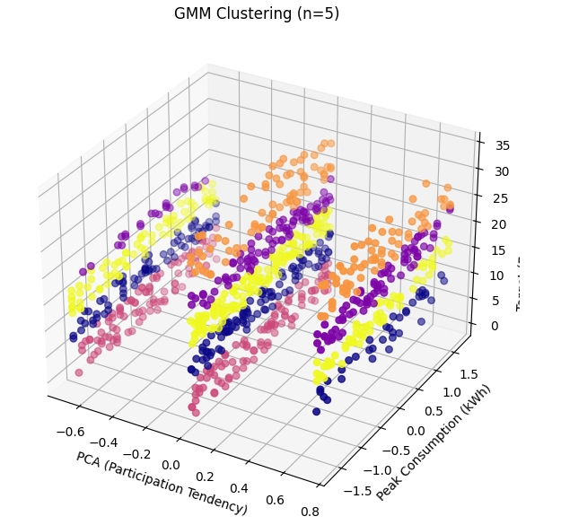
Gmm clustering (n=2 ~ 6)(N=2,5,6)
N= 2 (Easy to understand)
Structure too simple, includes many borderline samples
N = 5, 6
Over-segmented(interpretation gets harder, with small clusters)

Slide 22
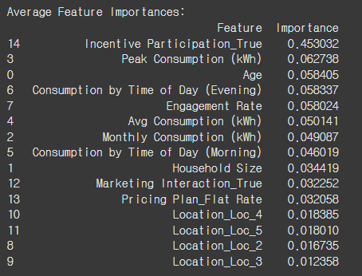
deployment
The type of pricing plan was expected to have the greatest effect on the reduction rate, but the impact of marketing was found to be greater.
Marketing strategies are more important than plans if you implement policies that require power savings

Slide 23
limitation
1) Lack of data
2) It does not specify exactly how the samples were sampled
3) If you change from flat price to dynamic price, tax resistance definitely exists, but it cannot be confirmed in this data.

Slide 24
impression
202031879 Lee Jaeseong : It was impressive to deal with the problems around us, and making various attempts to increase the accuracy of the model helped a lot in learning.
201935093 Lee dongjin : Through GMM clustering, we realized that data understanding and feature engineering are more crucial than modeling itself.
202035324 KIM TAEMIN : This project showed that in regression, weak feature-target correlation limits performance, making data understanding more crucial than modeling.

Slide 25
Reference & github
Gihub address : https://github.com/a4527/DataScience-Team4
Reference :
ChatGpt
https://www.kaggle.com/code/devraai/personalized-energy-marketing-analytics
https://bio-kcs.tistory.com/entry/cross-validation%EC%9D%84-%EC%A0%81%EC%9A%A9%ED%96%88%EC%9D%84%EB%95%8C-macro-average-ROC-curve%EA%B7%B8%EB%A6%AC%EB%8A%94-%EB%B2%95

